Slide 1
CS5351 Software Engineering 2025/2026 Semester A Code with Quality
Dr W.K. Chan
Department of Computer Science
Email: wkchan@cityu.edu.hk
Website: http://www.cs.cityu.edu.hk/~wkchan
Notes:
runnable on https://www.tutorialspoint.com/compile_java_online.php,

Slide 2
Coding
In an Agile method, developers sketch the software design write codes incrementally, and focus on delivering the tasks we pay attention to.
We unavoidably make mistakes during this “no-long-term-planning” (i.e., unsystematic) process.
Our code is (un)intentionally coupled with the customized nature of these tasks.
The design and code will likely change as developers’ understanding of the system to build is deepened.
The basic strategy is: Our code should be clean, minimal, and maintainable.
Question: How?
Notes:
Problem due to small window of tasks when working on coding a task:
Too narrowed view => over-simplistic design (quick, not general enough => more iterations, difficult to maintain or course other tasks difficult to code => impact analysis)
Too generalized => extra unnecessary efforts spent but not rewarded

Slide 3
Outline
Basic Low-Level Design Principles at Code Level
Code Smells
Code Refactoring

Slide 4
Basic Code Design Principles
There are a few basic design principles recommended to developers when they write code. We look at the core set of these design principles.
Abstraction
Information Hiding
Encapsulation
Coupling
Cohesion
S - Single-responsibility principle
O - Open-closed principle
L - Liskov substitution principle
I - Interface segregation principle
D - Dependency Inversion Principle

Slide 5
Example of Abstraction
A piece of code
Function signature
Abstract the
well-defined
functional purpose
int[] sort(int[] balls)
// balls[] is an integer array
int n = balls.length;
int temp = 0;
for(int i=0; i < n; i++){
for(int j=1; j < (n-i); j++){
if(balls[j-1] > balls [j]){
//swap elements
temp = balls [j-1];
balls [j-1] = balls [j];
balls [j] = temp;
}
}
}
//The function f will take X as input and output Y = f(x)
Function body
Abstraction
{
// balls[] is an integer array
int n = balls.length;
int temp = 0;
for(int i=0; i < n; i++){
for(int j=1; j < (n-i); j++){
if(balls[j-1] > balls [j]){
//swap elements
temp = balls [j-1];
balls [j-1] = balls [j];
balls [j] = temp;
}
}
}
}

Slide 6
Abstraction: Functional Purpose
Abstraction is a fundamental concept in programming theory.
It aims to avoid duplication of information and/or human effort.
Let C be a piece of code with a well-defined purpose.
e.g., C is the code listing to sort an array of integers.
Why not put C into the body of a function having a function signature F?
e.g., the function signature F is int[] sort(int[] balls)
We say that F is an abstraction of C. [More precisely, F is a functional abstraction of C]
A program P can include C once in the body of F and include one or more statements to call F instead of including multiple copies of C.
Developers of the client code U of F need not comprehend the code C; rather, they can rely on the abstraction F and its well-defined functional purpose to complete their own tasks (i.e., write the code for their purpose).
Change/revision in C can be local to F; these client codes should be transparent.
U becomes more readable as its code logic can focus on achieving its own purpose.
with this functional
purpose

Slide 7
Abstraction: Generalization
Apart from hiding C in the function F with a functional purpose, abstraction can also include the process of (1) finding similarities and/or common aspects and (2) forgetting unimportant differences.
Let {C₁, …, C_{i,}…, C_{n}} be codes with similar functional purposes.
F is a (common) abstraction of C₁, …, C_{i,}…, C_{n}.
The differences in parameters for individual ones among C₁, …, C_{i,}…, C_{n} are forgotten and unified as the same set of parameters in F.
Similarities among C₁, …, C_{i,}…, C_{n} are structured in F’s function body, and differences among them are put under different parts of the control flow structure in C.
Or in OO programming, we create a class hierarchy
The functional purpose of F is the common functional purpose of the individual functional purposes for C₁, …, C_{i,}…, C_{n}.

Slide 8
Abstraction
Rather than including {C₁, …, C_{i,} C_{j,}…, C_{n}} in the client code U, calling F can make developers of U incur less effort in integration
E.g., understanding the functional purpose of F is easier than reading all the code details; avoiding maintaining the code list explicitly
=> Make U more maintainable.
Note that F may not be more maintainable
The common abstraction F used in U helps U to ignore all differences among the details abstracted away by F.
i.e., clean and minimal
if we do abstraction right (i.e., the process of creating an abstraction is right) and do the right abstraction (the process deliverable is right)
Question: Suppose F is a function (e.g., like our sorting example on slide 5). Is it useful to create an interface for F?

Slide 9
Example 1 on Functional Abstraction
C₁
char* IsSmall(int x){
if (x > 0 && x < 10)
return “small”;
else
return “unknown”;
}
C₄
char* IsSmall(string x){
if ( childlike(x))
return “small”;
else
return “unknown”;
}
char * classify(int)
F
char * classify(string)
F
char* classify(int x){
if (x > 0 && x < 10)
return “small”;
elsif (x >=0 && x <= 20)
return “not small”;
elsif (x > 20)
return “other”;
else
return “unknown”;
}
C₂
char* IsNotSmall(int x){
if (x >= 0 && x <= 20)
return “not small”;
else
return “unknown”;
}
C
C₃
char* IsOther(int x){
if (x > 20)
return “other”;
else
return “unknown”;
}
….
cout << classify(8);
cout << classify(“:|p”);
….
U

Slide 10
Data Abstraction
Functional abstraction is to abstract the procedural steps in code.
If we abstract and group functions critically related to a data structure into a set, the set represents a single functional purpose of the data structure.
Function with functional abstraction = operators on the data structure
functional signatures = interfaces
Data Abstraction is to model the operators on a data structure as a set of related functions (called interfaces). In contrast, the data structure implementations are concealed by the interfaces.

Slide 11
Examples of Data Abstraction
Good example
Bad example
Stack() create a new stack
s.isEmpty() is s empty?
s.length() number of items in s
s.push(int x) push x onto s.
s.pop() remove and return the item most recently pushed onto s.
The data structure in s should be compatible to an integer array
Stack() create a new stack
s.isEqual(int[] X) is s equal to the integer array X?
s.length() number of items in s
s.set(int x,int i) put x at the position s[i].
s.get(int i) remove and return the item s[i], shorten the stack s.
s.push(int x, int i) implemented as s.set(int x, int i)
Does not obey the first-in-last-out property of stack

Slide 12
Bad Examples of Data Abstraction
Worse example
Completely expose the implementation of the data structure of the stack
Stack() create a new stack
s.isEqual(int[] X) is s equal to the integer array X?
s.length() number of items in s
s.set(int[] X) keep X as s.
s.get() return the data structure instance used by s,
and internally reset s to empty.

Slide 13
1-Minute Self-Reflection and Discussion
Bad example
Stack() create a new stack
s.isEqual(int[] X) is s equal to the integer array X?
s.length() number of items in s
s.set(int x,int i) put x at the position s[i].
s.get(int i) remove and return the item s[i], shorten the stack s.
s.push(int x, int i) implemented as s.set(int x, int i)
The Bad Example on slide 11 can serve wider scenarios than the Good Example on the same slide that does not expose the implementation of the data structure to the client code.
E.g., to know the value kept at the 3rd element in a stack, one call to the stack in the Bad Example can know the answer, whereas we need a sequence of calls to the stack in the Good Example to get the same answer.
Writing less code is productive, which is good!
As long as we use the operators in the Bad Example correctly, it should be OK!
What is your opinion?

Slide 14
Data Abstraction
The two loops produce equivalent sequences of integers in s1 and s2.
A developer, after reversing the loop order for the first loop, expects the processing in the 2nd loop to be reversed, but this is not the case. A small fix to the second loop does not resolve the problem.
Consider two pieces of client code using Bad Example:
for (int i = 0; i < n; i++) { …;s1.push(i,i);…}
for (int i = n; i > 0; i--) { …;s2.push(i,i);…}
Consider two pieces of client code using Good Example:
for (int i = 0; i < n; i++) { …;s1.push(i);…}
for (int i = n; i > 0; i--) { …;s2.push(i);…}
The sequence of integers in s1 is a reverse sequence kept in s2 (with each pair of elements differs by one), which follows the expectations of developers to reverse the looping order in the client code.
We can change s2 to keep s1’s elements by using s2.push(i-1) instead of s2.push(i).
Notes:
// example
class Good_Stack {
private int[] s = new int[16];
private int size = 0;
Good_Stack() {
// some statements.
}
public boolean isEmpty() {
return size==0;
}
public int length() {
return size;
}
public void push(int x) {
s[size] = x;
size++;
}
public int pop() {
int ret = s[size];
size--;
return ret;
}
public void print() {
for (int i=0;i<size;i++) {
System.out.print(s[i] + "");
}
System.out.println();
}
}
class Bad_Stack {
private int[] s = new int[16];
private int size = 0;
Bad_Stack() {
// some statements.
}
public boolean isEqual(int[] x) {
return s==x;
}
public int length() {
return size;
}
public void set(int x, int i) {
s[i] = x;
size++;
}
public int get(int i) {
int ret = s[i];
size--;
return ret;
}
public void print() {
for (int i=0;i<size;i++) {
System.out.print(s[i] + "");
}
System.out.println();
}
}
public class Client {
public static void main(String[] args) {
System.out.println("-------Good example-------");
Good_Stack s1 = new Good_Stack();
Good_Stack s2 = new Good_Stack();
for (int i=0; i<5; i++) {
s1.push(i);
}
for (int i=5; i>0; i--) {
s2.push(i);
}
System.out.println("s1 sequence:");
s1.print();
System.out.println("s2 sequence:");
s2.print();
System.out.println("-------Bad example-------");
Bad_Stack s3 = new Bad_Stack();
Bad_Stack s4 = new Bad_Stack();
for (int i=0; i<5; i++) {
s3.set(i,i);
}
for (int i=5; i>0; i--) {
s4.set(i,i);
}
System.out.println("s3 sequence:");
s3.print();
System.out.println("s4 sequence:");
s4.print();
}
}

Slide 15
What Make “Good Example” Work?
Consider two pieces of client code using Bad Example:
for (int i = 0; i < n; i++) { …;s1.push(i,i);…}
for (int i = n; i > 0; i--) { …;s2.push(i,i);…}
Consider two pieces of client code using Good Example:
for (int i = 0; i < n; i++) { …;s1.push(i);…}
for (int i = n; i > 0; i--) { …;s2.push(i);…}
After each invocation of an operator (i.e., push()) of an abstract data type, the integrity of the data structure should be kept intact. To ensure intact, the changes kept on the data structure should only be performed by these operators.
This is the case for Good Example
This is not the case for Bad Example
This is also not the case for Worse Example
A client code can change the internal data structure for the stack.
For using the interface of stack in Good Example, a checking on data structure integrity can be more lightweight => more efficient and less complex code.

Slide 16
Data Abstraction
The Bad Example is a special kind of array manipulation.
Rather than calling it “Stack” to mislead developers, we rename it to myArray, and implement Stack on top of myArray.
Stack() create a new stack. Implemented by a = myArray()
s.isEmpty() is s empty? Implemented by a.isEqual(myArray())
s.length() number of items in s. Implemented by a.length()
s.push(int x) push x onto s. Implemented by a.set(x, a.length()+1)
s.pop() remove and return the item most recently pushed onto s.
Implemented by a.get(x, a.length())
myArray() create a new array
a.isEqual(int[] X) is a equal to the integer array X?
a.length() number of items in a
a.set(int x,int i) put x at the position a[i].
a.get(int i) remove and return the item a[i], shorten the array a.
Notes:
import static java.lang.System.out;
// example
class myArray {
private int[] a = new int[16];
private int size = 0;
public myArray() {
// some statements.
}
public boolean isEqual(myArray array) {
return a==array.a;
}
public int length() {
return size;
}
public int get(int i) {
size--;
return a[i];
}
public void set(int x, int position) {
a[position] = x;
size++;
}
}
class Stack extends myArray {
myArray a = new myArray();
public Stack() {
// some statements.
}
public boolean isEmpty() {
myArray temp = new myArray();
return a.isEqual(temp);
}
public int length() {
return a.length();
}
public void push(int x) {
a.set(x, a.length());
}
public int pop() {
return a.get(a.length());
}
}
public class Test
{
public static void main(String[] args)
{
Stack s = new Stack();
s.isEmpty();
out.println(" length is now " + s.length());
s.push(1);
out.println(" length is now " + s.length());
s.pop();
out.println(" length is now " + s.length());
}
}

Slide 17
Information Hiding and Encapsulation
In mathematics, we have the concept of Projection.
[Information Hiding] is the interface to access
[Encapsulation] Via the interface, we cover up all the information about y of
(e.g., the point (3, 2) of Circle is a value of 3 externally)
y
(3, 2)
The projection of the circle on Dimension x results in a line segment
x
Still able to recall what is an interface (of a data structure)?
(0,0)

Slide 18
Information Hiding
Interfaces should be chosen to reveal as little as possible about its internal workings.
We should ask whether the level of details specified in the parameters of an operator in an interface is essential.
// canVote1 and canVote2 provide the same functionality
// to determine whether a person holding HKID is over 18 years old
// and is a valid voter in a particular district
boolean canVote1(int HKID, int age, int district_code) {…};
boolean canVote2(Voter v) { v.votable();};
{ Voter v = new Voter(123456, 28, 12);
canVote1(v.HKID, v.age, v.district_code);
canVote2(v);
}
Which one is better?
canVote1( ) reveals more details than canVote2( )
Notes:
canVote2 is better than canVote1.

Slide 19
Encapsulation
Encapsulation on X refers to ensuring outsiders cannot gain knowledge about certain information internal to X.
X can be a class, a module, a file, a data record, etc.
X can also represent internal data, algorithms, etc.
Idea: We achieve good encapsulation if we can describe the functional purpose using the least “working known-how” of the operators of a data structure and the functional signature does not specify more than what the functional purpose states.
If not, the client code U knows the details of the function. If U uses this knowledge to make customized code, the integrity of the data structure will be compromised.

Slide 20
Encapsulation Violation
// client code C
{
MyArray a;
Stack s = Stack(a);
s.push(1);
a.get(0);
assert(s.isEmpty());
}
The code C fails its assertion. Stack s should protect its internal implementation to make it intact. But now, the variable a is manipulated outside s, which corrupts s.
Consider Stack and myArray modified from slide 16 and the client code C to use them.
Stack(a) create a new stack. Implemented by keeping a internally
s.isEmpty() is s empty? Implemented by a.isEqual(myArray())
s.length() number of items in s. Implemented by a.length()
s.push(int x) push x onto s. Implemented by a.set(x, a.length()+1)
s.pop() remove and return the item most recently pushed onto s.
Implemented by a.get(x, a.length())
myArray() create a new array
a.isEqual(int[] X) is a equal to the integer array X?
a.length() number of items in a
a.set(int x,int i) put x at the position a[i].
a.get(int i) remove and return the item a[i], shorten the array a.
Notes:
// code example
class myArray {
private int[] a = new int[16];
private int size = 0;
public boolean isEqual(myArray s) {
return a == s.a; // bug here
}
public int length() {
return size;
}
public void set(int x, int pos) {
a[pos] = x;
size++;
}
public int get(int pos) {
int ret = a[pos];
size--;
return ret;
}
public void print_array() {
for (int i=0; i<size; i++) {
System.out.println(a[i]);
}
}
}
class Stack extends myArray {
private myArray a;
Stack(myArray input) {
a = input;
}
public boolean isEmpty() {
myArray temp = new myArray();
return a.isEqual(temp);
}
public int length() {
return a.length();
}
public void push(int x) {
a.set(x, a.length());
}
public int pop() {
return a.get(a.length());
}
public void print_stack() {
a.print_array();
}
}
public class Client {
public static void main(String[] args) {
myArray a = new myArray();
Stack s = new Stack(a);
s.push(1);
a.get(0); // corrupted the data structure Stack.
if (s.isEmpty()) System.out.println("empty");
else System.out.println("non-empty");
assert(!s.isEmpty());
}
}

Slide 21
Encapsulation Example
We can control the visibility of each data member or data method of a class to increase the level of encapsulation.
Question: By controlling the visibility, does it mean that developers need not consider the information stated in the input and output parameters?
See the next slide for an answer.
public class Stack {
public int[] a;
public int size;
Stack(){…}
public boolean isEmpty() {…}
public length() int() {…}
public void push(int x){…}
public int pop(){…}
}
public class Stack {
private int[] a;
private int size;
Stack(){…}
public boolean isEmpty() {…}
private length() int() {…}
public void push(int x){…}
public int pop(){…}
}
Notes:
// First example
public class Stack {
public int[] a = new int[16];
public int size = 0;
Stack() {
//some statements.
}
public boolean isEmpty() {
return size==0;
}
public int length() {
return a.length;
}
public void push(int x) {
a[size++] = x;
}
public int pop() {
if (size==0) {
throw new IllegalArgumentException("The stack is empty!");
}
else {
int temp = a[size-1];
size--;
return temp;
}
}
public void print_stack() {
if (size==0) {
System.out.println("The stack is empty.");
}
else {
for (int i=0; i<size; i++) {
System.out.println(a[i]);
}
}
}
public static void main(String[] args) {
Stack a = new Stack();
a.print_stack();
a.push(1);
a.print_stack();
a.push(2);
a.print_stack();
a.pop();
a.print_stack();
a.pop();
a.print_stack();
}
}
=========================================
//Second example
public class Stack {
private int[] a = new int[16];
private int size = 0;
Stack() {
//some statements.
}
public boolean isEmpty() {
return size==0;
}
private int length() {
return a.length;
}
public void push(int x) {
a[size++] = x;
}
public int pop() {
if (size==0) {
throw new IllegalArgumentException("The stack is empty!");
}
else {
int temp = a[size-1];
size--;
return temp;
}
}
public void print_stack() {
if (size==0) {
System.out.println("The stack is empty.");
}
else {
for (int i=0; i<size; i++) {
System.out.println(a[i]);
}
}
}
public static void main(String[] args) {
Stack a = new Stack();
a.print_stack();
a.push(1);
a.print_stack();
a.push(2);
a.print_stack();
a.pop();
a.print_stack();
a.pop();
a.print_stack();
}
}

Slide 22
Encapsulation Violation Example
We should also control the input/output parameters.
public class Stack {
private int[] a;
private int size;
Stack(){…}
public boolean isEmpty() {…}
private length() int() {…}
public void push(int x){…}
public int pop(){…}
public int getSize(){ return size; }
public void setSize(int n) { size = n;}
}
The client code C
{
Stack s = new Stack();
s.push(1);
int n = s.getSize();
// C knows the value of the data
// member size of s now.
s.setSize(n/2);
}
Notes:
// example
public class Stack {
private int[] a = new int[16];
private int size = 0;
Stack() {
//some statements.
}
public boolean isEmpty() {
return size==0;
}
private int length() {
return a.length;
}
public void push(int x) {
a[size++] = x;
}
public int pop() {
if (size==0) {
throw new IllegalArgumentException("The stack is empty!");
}
else {
int temp = a[size-1];
size--;
return temp;
}
}
public void print_stack() {
if (size==0) {
System.out.println("The stack is empty.");
}
else {
for (int i=0; i<size; i++) {
System.out.println(a[i]);
}
}
}
public int getSize() {
return size;
}
public void setSize(int n) {
size = n;
}
public static void main(String[] args) {
Stack s = new Stack();
s.push(1);
int n = s.getSize();
System.out.println("The size of the stack is " + n);
}
}

Slide 23
Check …
Fundamental concepts
Abstraction: separate interface from implementation with a purpose
Information hiding: remove details from the interfaces of a data structure (by interrelating these interfaces)
Encapsulation: restrict gaining knowledge about the implementation details of the code to its client code
data structure
Interface 1
Interface 2
….
….
….
….
….
….
implementation

Slide 24
Question
Study the following lines of code.
Do they model any Functional Abstraction?
Do they model any Information Hiding?
Does the function encapsulate the details enough?
// computePolygonArea computes the area bounded by the consecutive lines connected by the points in pointList.
double computePolygonArea(int[] pointList,
int polygonType)
{
if polygonType = triangle then ...//alg 1
elsif polygonType = square then ...// alg 2
…
}
Notes:
Abstraction: yes
Information hiding: yes, hide alg 1, alg 2 etc
Encapsulation: no. polygontype is not stated in the functional purpose.
The two input paramaeters should be wrapped into an object like “Polygon” and the function PolygonArea is an operator of this Polygon data structure

Slide 25
Coupling and Cohesion
Coupling is about syntactic dependency.
Our aim: minimize coupling in the code listing
Cohesion is about the reasons to place a set of entities together as a group or split them.
We cannot see the dependency on cohesion from the code
Our aim: If two entities are related, they should be grouped together and/or used together.
Consequence: Higher cohesion and lower coupling together lead to higher quality: maintainability, reusability, and lower complexity

Slide 26
Coupling
An entity X is structurally and directly dependent on another entity Y at compile time (when the code is not yet run).
= there is a direct structural dependency from X to Y.
Programmers need such dependency info for computational efficiency
Compiler needs it for code optimization
We often “hard-code” the dependency in the source code
Component, dataflow, control flow
double x1, x2, w1, w2;
…
while (x1 > 0.003) {
y = x1*w1 + x2*w2;
x1 = x1 – 0.01*y;
}
class Parent {
//code for the parent class
}
class Child extends Parent {
//code for the child class
}

Slide 27
Coupling
Property:
If X is changed (e.g., deleted/changed its datatype), then Y changes too.
Consequence:
If Y changes (as the result of X), elements (say Z) depend on Y changes too
Z is indirectly dependent on X.
If we can either (1) reduce coupling at the compile time or (2) delay the dependency from compile time to run time (when the code is run), then we make our program have better kinds of coupling.
propagate to caller
double int f(double int x) { return x;}
void g(double int x)
{ double int x = f(x);}
propagate and propagate
…
double int f(double int x) { return x;}
void h(x){g(2.3);}

Slide 28
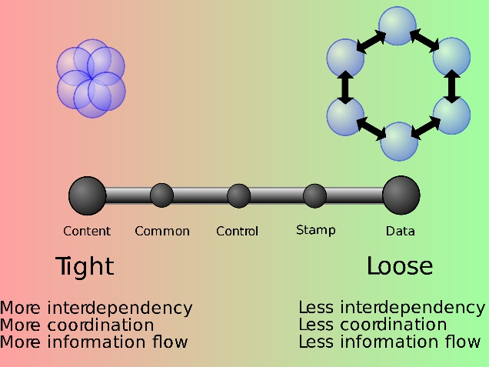
Coupling
Six basic types of coupling
Content (directly use a part of code)
Common (global variable)
External (interface protocol, file)
Control (control flow, workflow pipeline)
Stamp (a part of a data structure)
Data (the whole data structure)
worse
better

Slide 29
e.g., External Coupling
current
f(file X){
read y from file X
}
g(file X, data z){
read y from file X
y = y + z;
replace y by z in file X
}
g
X
f
Suppose g and f are changed so that they pass their needs to a new entity u to access X. Then, the external coupling in the application is reduced.
g’
u’
X
We can see from this example that program structure is important.
f’

Slide 30
Cohesion
7 types of cohesion
Coincidental (grouped without a reason)
Logical (grouped because “we” treat them as one category)
Temporal (A part of each entity in the group is processed similarly)
Procedural (A group of functions, when composed, represent different sequences of control of abstraction (e.g., a file))
Communicational (grouped because of operating on the same data)
Sequential (the input of one depends on the output of another)
Functional (to perform different aspects of a well-defined task)
worse
better

Slide 31
A bubble sorting program
class A {
greater(x, y) { return (x>y);}
swap(array Z, i, j) { k = z[i]; z[i] = z[j]; z[j] =k;}
}
class B {
sort(array Z, n){
A a;
loop i=1…n do
loop j=1…n do
if a.greater(Z[i], Z[j])
then a.swap(Z, i, j);
}
}
procedural cohesion within class A
control coupling from B.sort(.) to A.greater(.)
data coupling from B to A
functional cohesion within class B

Slide 32
SOLID in Object-Orientation
Abstraction, Information Hiding, and Encapsulation are fundamental.
There are also many other more pragmatic guidelines to help developers to organize their code better. One of the most popular ones is categorized as SOLID:
S - Single-responsibility principle
O - Open-closed principle
L - Liskov substitution principle
I - Interface segregation principle
D - Dependency Inversion Principle
Notes:
There are other OO design principles:
e.g., GRASP https://en.wikipedia.org/wiki/GRASP_(object-oriented_design)

Slide 33
SOLID S - Single-responsibility principle (SRP)
A responsibility as a logical reason to change the code.
It is an abstract concept.
The principle states that a class should have one and only one reason to be rewritten.
A responsibility is not the assigned functionality of the class.
It is a derived concept of maintaining good abstraction.
E.g., a class SortedList takes up the “logical” responsibility of “modeling a sorted sequence.” Anything related to changing how a sorted sequence is modeled, it should be done within SortedList.
If SRP is respected, then the responsibility means delivering the functional purpose of the class.

Slide 34
SOLID Example of SRP
Note that the keywords private/public are shown to follow the Java syntax only. They do not mean anything related to SRP.
public class Stack {
private int[] a;
private int size;
Stack(){…}
public boolean isEmpty() {…}
private length() int() {…}
public void push(int x){…}
public int pop(){…}
}
These changes serve as the reasons to maintain the Stack class so that the class continues to behave like a first-in-last-out data type.
Why do we want to change the code in the class Stack?
Implement a faster algorithm for the same purpose?
Fix bugs in the existing code?
Change to use another data structure/framework instead of int[]?
Implement missing requirements required to model Stack?
…

Slide 35
SOLID O - Open-closed principle (OCP)
Open-closed principle requires a code pattern to meet two conditions:
Open for extension, and Close for modification
The basic rule of OCP is:
(1) extend without modifying the existing code or
(2) refine the implementation without changing the functional purpose and input/output arguments.
Note that once a class’s abstract/virtual method is set as “null” in a subclass, do not extend the method with additional code in any subclass of the former subclass.

Slide 36
SOLID Counter-Example of OCP
class Employee{
enum Type {MONTHLY, DAILY }
Type type;
void paySalary() {
...
switch (type) {
case MONTHLY:
doThis();
break;
case DAILY:
doThat();
break;
}
...
}
}
How to add more types of employees to the Contract term?
We have to modify the statement on enum and add an extra switch case.
Notes:
https://www.geeksforgeeks.org/inheritance-in-java/

Slide 37
SOLID Example of OCP
class Employee{
SalaryType type;
void receiveSalary() {
...
type.doThis();
...
}
}
class SalaryType
{ void doThis() {}; }
class MonthlySalaryType extend SalaryType
{ void doThis() {…} }
class DailySalaryType extend SalaryType
{ void doThis() {…} }
The code on this slide is closed for modification even collaborating with new (and future) subclasses of SalaryType to provide new behaviors.
Notes:
https://www.geeksforgeeks.org/inheritance-in-java/

Slide 38
SOLID Counter-Example of OCP
class Employee{
SalaryType type;
void receiveSalary() {
...
if (type instanceof
MonthlySalaryType)
type.doThis();
elseif (type instanceof
DailySlarayType)
type.doThis();
...
}
}
class SalaryType
{ void doThis() {}; }
class MonthlySalaryType extend SalaryType
{ void doThis() {…} }
class DailySalaryType extend SalaryType
{ void doThis() {…}
}
The code on this slide violates OCP. To collaborate with one more subclass of SalaryType, the code in receiveSalary() should be changed.
Notes:
https://www.geeksforgeeks.org/inheritance-in-java/

Slide 39
5-minute Exercise on OCP https://stackoverflow.com/questions/37035474/am-i-violating-the-open-closed-principle/37035731
Scenario: I stored an array of doubles in a class field Measurements in the class MeasureData. I use this data to perform some calculations (e.g., compute the arithmetic mean of the array, the maximum, and the minimum). At the moment, I don't know if in the future I'll need to do any other operation on those data (e.g., maybe I will need to get the standard deviation). I'll have many objects of the class MeasureData.
Solution: I could write a class Calculator, declare it final, use a private constructor, and use several static methods to perform the necessary calculations. This makes sense since Calculator acts as a utility class, without any field, much like the standard Math class.
Problem: if, in a couple of months, I'll need to do any other calculation, I’ll need to write another static method in Calculator. Does this mean to violate the open/closed principle?
What is your suggestion to the problem?
Notes:
The original question: https://stackoverflow.com/questions/37035474/am-i-violating-the-open-closed-principle/37035731
Answer from stackoverflow.com
-----------------------
The strict answer is yes; OCP states that a class is open for extension but closed for modification. You would be modifying Calculator, and, hence, violating OCP (as you've already concluded).
This leads to two points:
First, is violating OCP a big deal in this case? You're additively changing Calculator to add a new method to it. Calculator is a static helper class used to get meaningful data from your objects. Adding a new method, like calculating SD, is not going to affect any of the other operations within it. With a proper implementation, is there really a way that adding this method could compromise your project?
Second, if you feel like the OCP violation is not acceptable, then this is a textbook example of where Strategy Pattern can be utilized. Consider:
Measurements.Java
public class Measurements { private int[] data; public Measurements(int[] data) { this.data = data; } public Number performCalculation(Calculation c) { return c.performCalculation(data); } }Calculation.java
public interface Calculation { Number performCalculation(int[] data); }
You can then make a calculation class for each different calculation you want to do on the data (eg: MeanCalculation, StdDevCalculation, etc.). If you want a new calculation (eg: MedianCalculation), you can make this without modifying any of the other code in this area (closed for modification, open for extension; OCP compliant). The end result looks like:
Measurements values = ... Number mean = values.performCalculation(new MeanCalculation()); Number SD = values.performCalculation(new StdDevCalculation()); // etc.I'm not saying this is the best approach (or best implementation of the approach even) for your specific case; you need to answer that for yourself. But I hope this answer provides a decent external perspective on the matter.

Slide 40
SOLID L - Liskov substitution principle (LSP)
Suppose S is a subclass of T. (= T is a generalization of S)
S can be reasoned in every client code C in the same way as T is reasoned in C. (= T’s behavior is preserved by S)
In this case, LSP [2] is followed by the pair of S and T.
E.g., S may refine or extend T
S refines T. E.g., S and T compute the same result, but S implements a better algorithm or uses a better data structure
S extends T. E.g., S inherits everything from T and does extra things
Duck is an LSP-kind subclass of Bird
We can reason a duck as a bird whenever we reason the behavior of a bird in general.
Integer is a not subtype of Float. [do not have fractional math]

Slide 41
SOLID Example of LSP
class Employee {
SalaryType type;
void receiveSalary() {
...
type.doThis();
...
}
}
class Manager extend Employee
{ void manageEmployee()
{…};
}
Manager is a subtype of Employee (as they are employed by a company) and a manger not only receives salary but also manage his/her subordinates.
Notes:
https://www.geeksforgeeks.org/inheritance-in-java/

Slide 42
SOLID Counter-Example of LSP
class Employee extend Manager {
SalaryType type;
void receiveSalary() {
...
type.doThis();
...
}
// overridden by a dummy
void manageEmployee() {null;};
}
class Manager
{ void manageEmployee()
{…};
}
Employee is a subtype of Manager. Since an employee in general does not supervise other employees, the function manageEmployee is overridden by a dummy method implementation.
Notes:
https://www.geeksforgeeks.org/inheritance-in-java/

Slide 43
SOLID I - Interface segregation principle (ISP)
ISP states that a client (of an interface) should not be forced to depend on methods (i.e., implement the methods) it does not use.
Warning: ISP has no theoretical basis.
It is a handy concept to avoid some problematic designs.
E.g., implementing too many dummy codes to conform to the interfaces for later use (which may never appear).
Developers are forced to implement the dummy functions in an interface due to the programming language/compiler we chose to use.

Slide 44
SOLID Counter-Example of ISP
interface ColorScheme {
void renderInRGB(byte[] image);
void renderInYUV(byte[] image);
void renderInHSV(byte[] image);
}
The interface ColorScheme is not well-suitable for the code project as two methods are forced to be concretized by myDisplay even though myDisplay has no interest in them.
class myDisplay implements ColorScheme {
void renderInRGB(byte[] image) {...}; // actual need of this class
void renderInYUV(byte[] image) { }; // dummy, useless
void renderInHSV(byte[] image) { }; // dummy, useless
}

Slide 45
SOLID Example of ISP
Split ColorScheme into multiple interfaces
interface RGBColorScheme { void render(byte[] image);}
interface YUVColorScheme { void render(byte[] image);}
interface HSVColorScheme { void render(byte[] image);}
class myDisplay implements RGBColorScheme {
void render (byte[] image) {...}; // actual need of this class
}
No need to add dummy implementation of the unused interface method signatures

Slide 46
Counter-Example of ISP
screen
X cannot provide a general interface for subclasses with incompatible calling sequence
a1
c1
a3
b4
Client C = {
X x[];
loop:
code to maintain x;
fetch position i
fetch action e
switch (e) {
“f”: call x[i].f(); break;
“g”: call x[i].g(); break;
“h”: call x[i].h(); break;
}
}
Interface X = { f, g, h }
Subclass A
no constraint on the order of function calls
Subclass B
should call f before g; otherwise, g has no effect
Subclass C
should call g before f, otherwise f has no effect
Error in execution

Slide 47
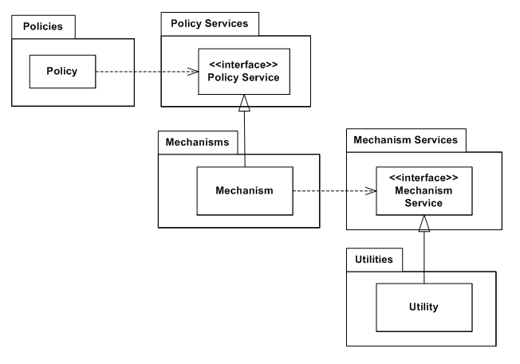
SOLID D - Dependency Inversion Principle (DIP)
DIP requires both conditions below to be held:
High-level modules should not depend on low-level modules. Both should depend on abstractions.
Abstractions should not depend on details. Details should depend on abstractions.
Higher-level modules
Abstraction of classes at a lower level are placed in the upper level. Classes at the same level collaborate without referencing to classes from lower levels.
Lower-level modules
https://en.wikipedia.org/wiki/Dependency_inversion_principle

Slide 48
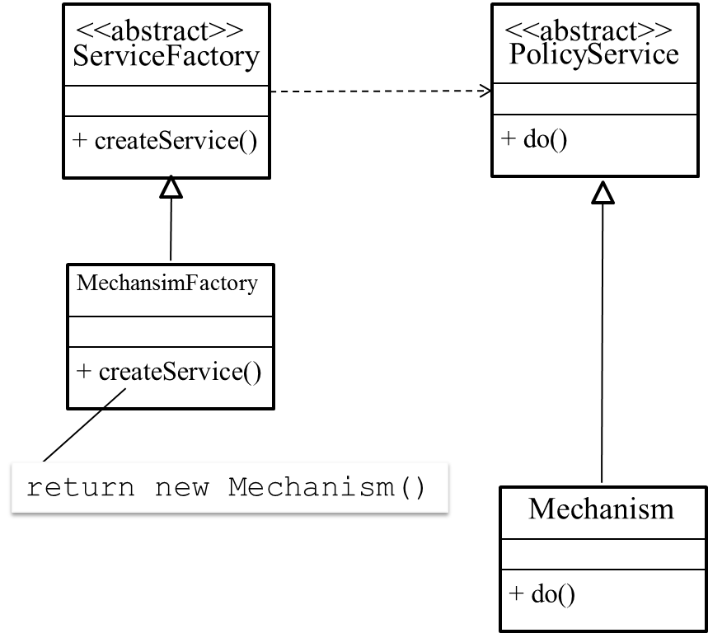
Dependence Injection
Still recall what I wrote on whiteboard in Week 1?
Release 1 (frozen)
Release 1 (developing)
A
abs B
B2
abs C
B1
C1
At the top level, PolicyService is an interface, and yet a Policy object needs to call a concrete object. We may inject a dependency Mechanism object to the Policy object.
class Policy {
PolicyService ps;
Policy(PolicyService s)
{ps = s;}
void usePS()
{ps.do();}
}
…
foo()
{… ServiceFactory sf = new
MachansimFactory();
Policy p = new
Policy(sf.createService());
}
Pass an object when constructing a Policy object. We need a Mechanism factory to create the former object.

Slide 49
Summary
Fundamental concepts
Abstraction: separate interface from implementation
Information hiding: remove details from interface
Encapsulation: restrict accesses to methods and info of data members; do not expose implementation details to client code
Popular design guidelines
SRP: one purpose for making change to a class
OCP: extending behavior without changing the source code
LSP: a subclass can do whatever a superclass does logically
ISP: do not force a client code to implement unwanted methods
DIP: a higher level entity does not depend on a lower level entity

Slide 50
Code Smells [also known as anti-patterns]
Code smell is a violation of a design principle and causes an adverse effect to the code.
Notes:
Many possible metrics
Inefficient code in general
Code when input parameters in outliner range will result in performance bloat
Risky code, difficult to make modification
Violation of design principles

Slide 51
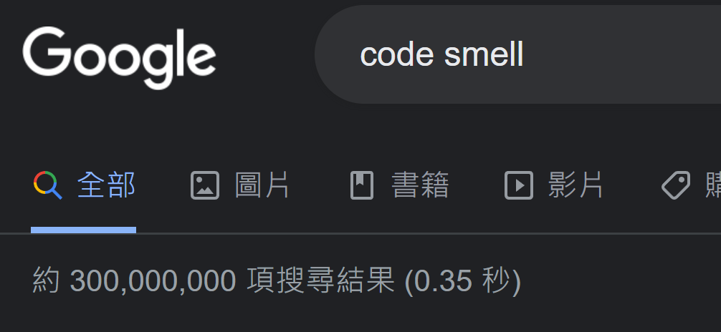
Code Smells
Code smell is a violation of a design principle and (potentially) harms the code.
Novice developers tend to find it more difficult to judge the presence of them in their code.
Code Review is a good source for the team to manage the code
Some static analysis tools can help detect code smells.
Learn from the folks (large language models too?)

Slide 52
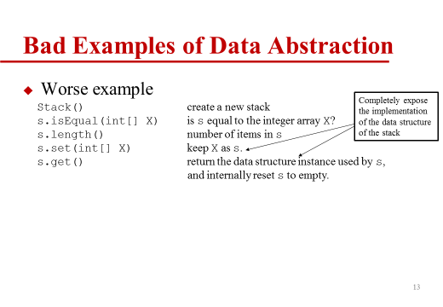
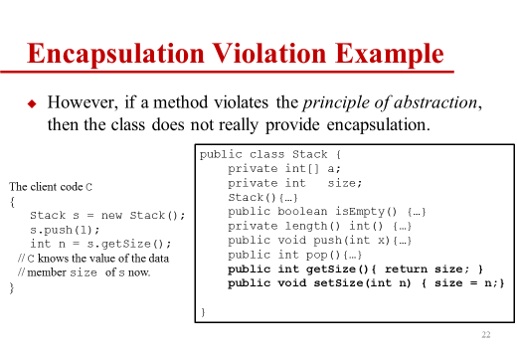
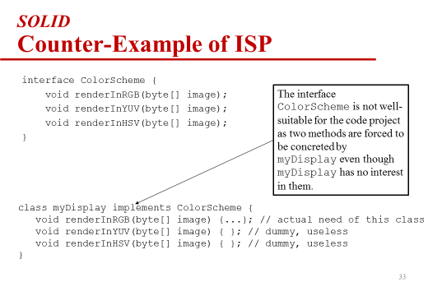
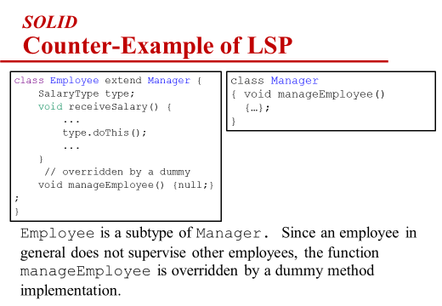
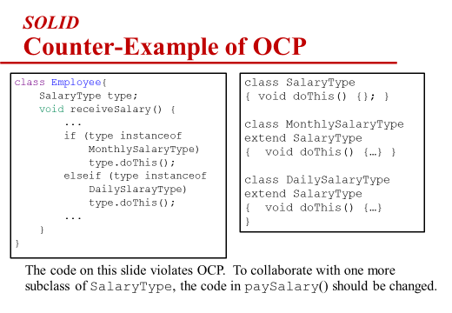
Code Smell
We have seen counter-examples of various principles on previous slides.

Slide 53
Many Possible Code Smell Patterns
Most of them are guidelines only
22 patterns were identified initially [7], and more were identified afterwards [8].

Slide 54
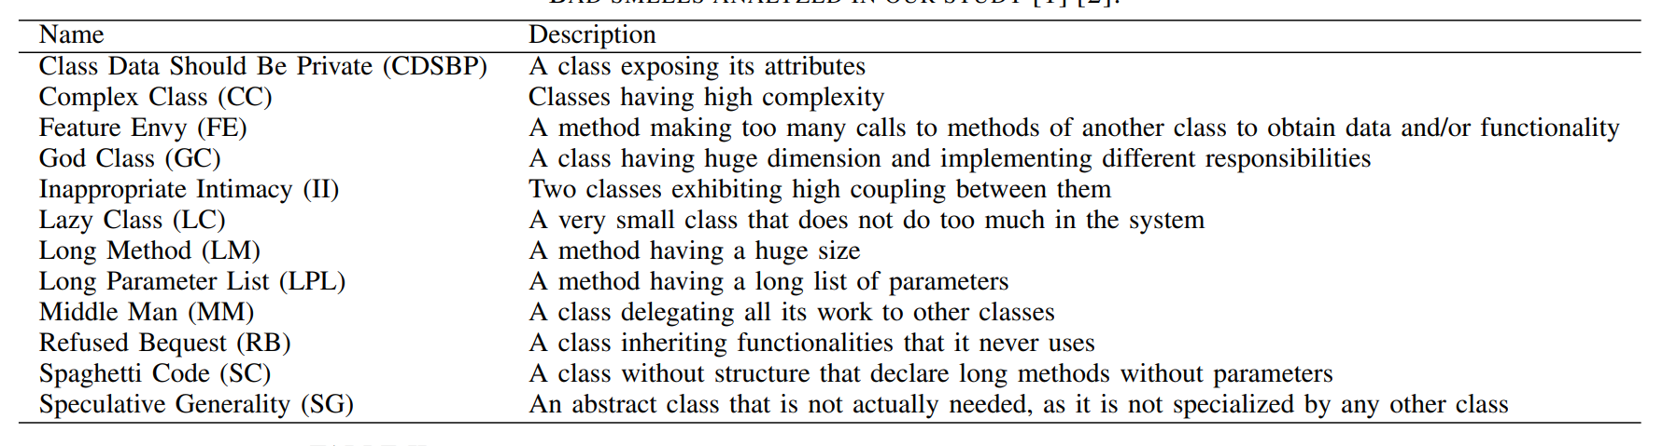
Example Code Smells (don’t memorize them)
1
2
3
2
1
1
2
1
1
3
2
3
References:
[1] M. Fowler, Refactoring: improving the design of existing code. Addison-Wesley, 1999.
[2] W. J. Brown, R. C. Malveau, W. H. Brown, et al., Anti Patterns: Refactoring Software, Architectures, and Projects in Crisis, 1st ed. John Wiley and Sons, March 1998.
[3] F. Palomba et al. Do they Really Smell Bad? A Study on Developers’ Perception of Bad Code Smells. In ICSME’14. pp 101-110, 2014.
Not perceived as design/implementation problems: CDSBP, MM, LPL, LC, II
Perceived as design/implementation problems: CC, GC, LM, SC
Gray areas: FE, RB, SG

Slide 55
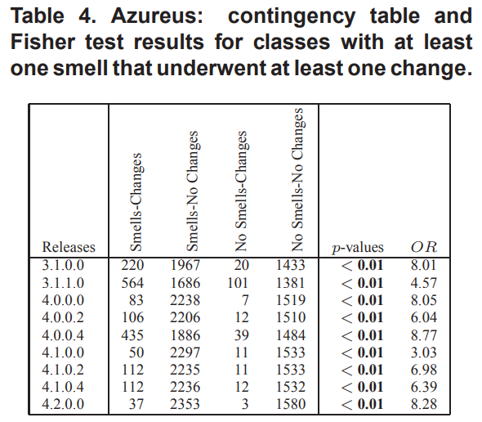
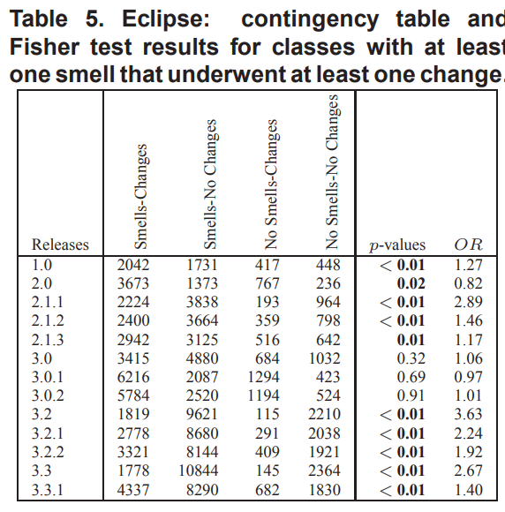
What is the Impact of Code Smells on Code Stability and Bug Fix?
A study [3, 4] on ArgoUML, Eclipse, Mylyn, and Rhino, Azureus
Classes with code smells change more often than the otherwise.
They also incur more in issue-fixing or fix-bugging patches
Classes with more code smells change more often than the classes with less code smells
It means that the code degraded

Slide 56
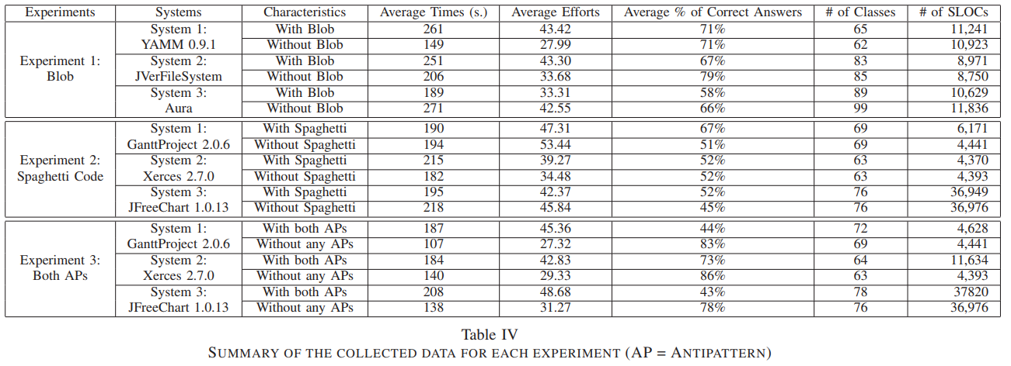
What is the Impact of Code Smells on Program Comprehension?
A program comprehension study [6] on code incurring Blob (i.e., code difficult to work with) and Spaghetti Code as code smells
Programs incurring these two anti-patterns are more time consuming, need more effort, and lead developers to answer comprehension questions less correctly, but not reading more classes
Notes:
The Blob is also frequently a result of iterative development where proof-of-concept code evolves over time into a prototype, and eventually, a production system

Slide 57
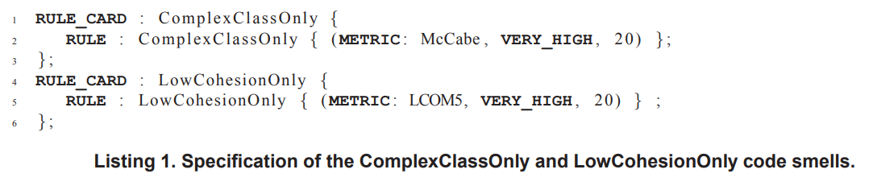
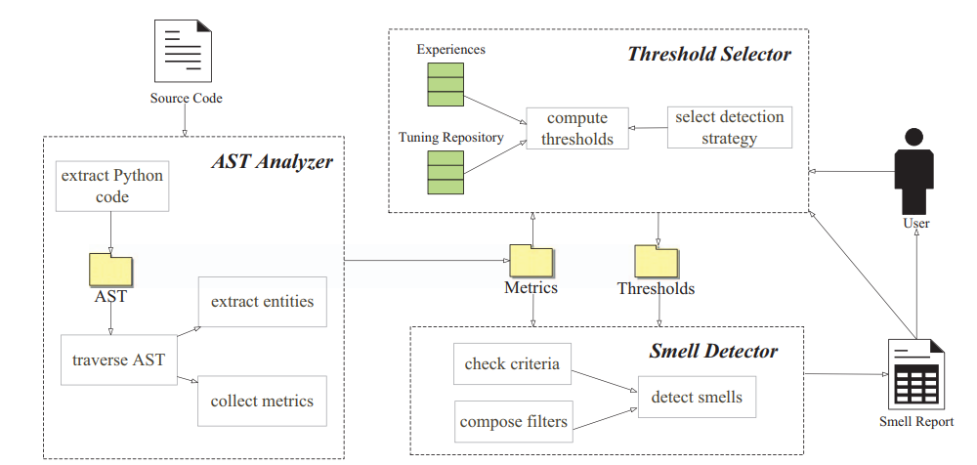
How to Automate Code Smells Detection?
Formulate what constitute a code small [3]
Then, mine the code [6] to extract entities and compute metric values
Many open-source code can generate the control flow graph or AST of a project written in any programming language.
There are also many code projects to compute various metrics

Slide 58
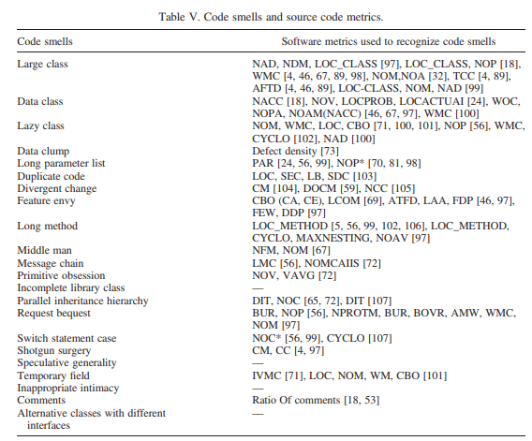
Some Code Smell Patterns can be Formulated Successfully [don’t memorize them]
Source Code Metrics: AMW, average method weight; ATFD, access to foreign data; BOvR, base-class overriding ratio; BUR, base-object usage ratio; CBO, coupling between objects; CC, changing classes; CM, changing methods; Ca, afferent coupling; Ce, efferent coupling; CYCLO, McCabe’s cyclomatic complexity; DOCM, dependency-oriented complexity metric; DIT, depth inheritance hierarchy; FDP, foreign data providers; LAA, locality of attribute accesses; LB, line bias; LMC, length of message chain; LCOM, lack of cohesion between methods; LOCprob, number of line of code for data fields, methods, imported packages, and package declaration; LOCactual, total line of code; LOC, lines of code; IVMC, number of methods that reference each instance variable defined in a class; LOC_CLASS, lines of code in a class; LOC_Method, lines of code in a method; MAXNESTING, counts the maximum nesting level of control structures within an operation; NAD, number of attributes in a class; NBD,nested block deptmethods; NCC, number of concerns per component; NOM, number of methods; NACC, number of accessors (getter/setter); NOV, number of variables per class; NOMcalls, number of method calls; NOC, number of children; NOC*, number of cases; NProtM, number of protected members; NOP*, number of parameters; NOPA, number of public attributes; NOAM, number of accessor methods; NOP, number of properties; PAR, number of parameters; NOAV, counts the number Of accessed variables; SEC, size of exact chunk; SDC, size of duplication chain; WMC, weighted methods per class; Vavg, average count on the number of variables; WOC, weight of a class

Slide 59
Refactoring

Slide 60
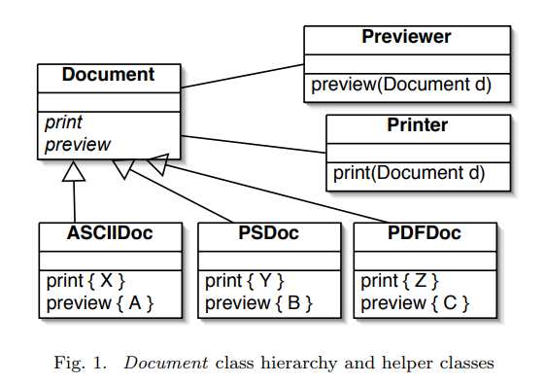
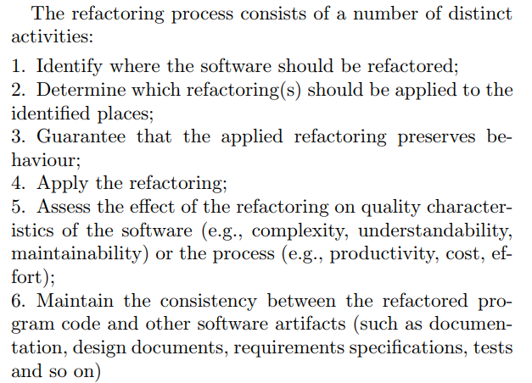
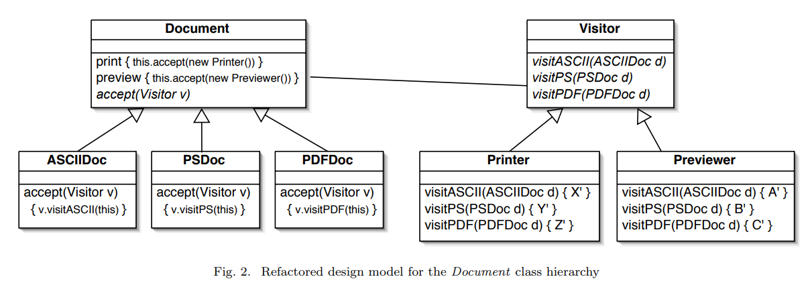
Refactoring [10]
To improve code structure and organization
Triggering points: code review and in code maintenance

Slide 61
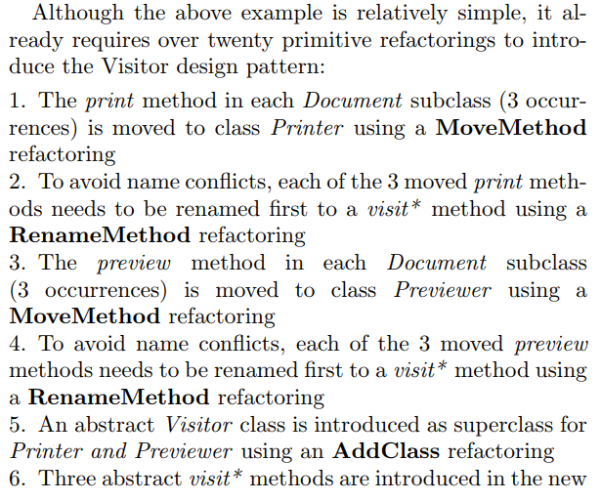
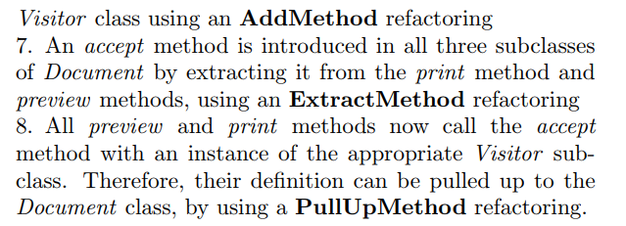
A Refactoring Process [10]

Slide 62
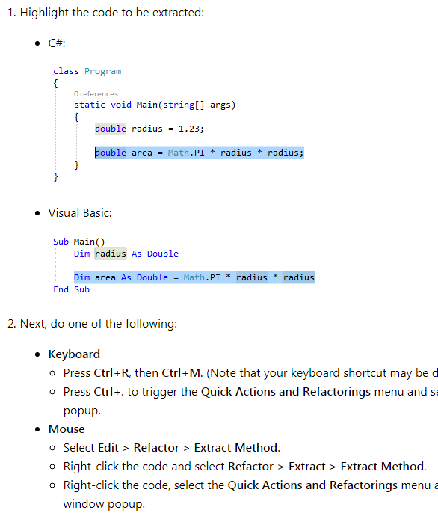
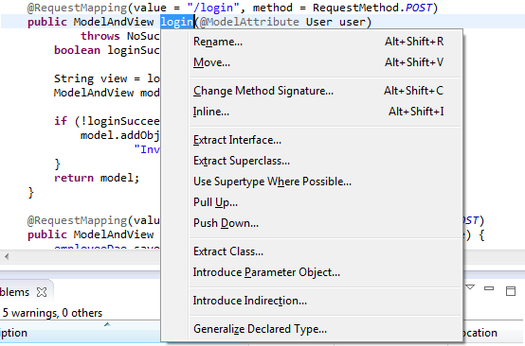
Removal of Code Smells
Every good IDE (e.g., Eclipse, Visual Studio) has a menu of popular refactoring to assist developers to manage their code.
Use them or do it manually
Press “Alt + Shift + T” in Eclipse
Press “Ctr+” in Visual Studio

Slide 63
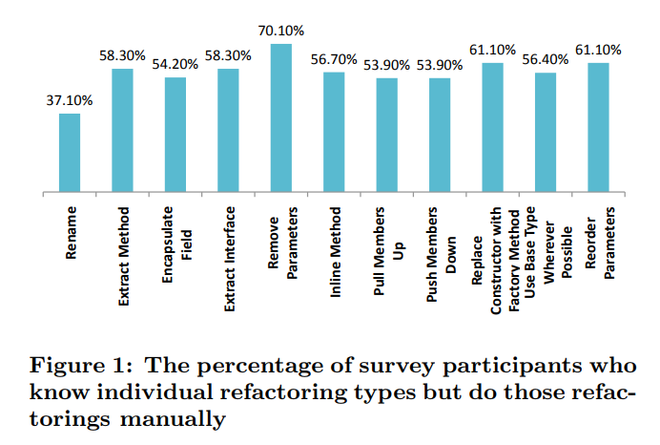
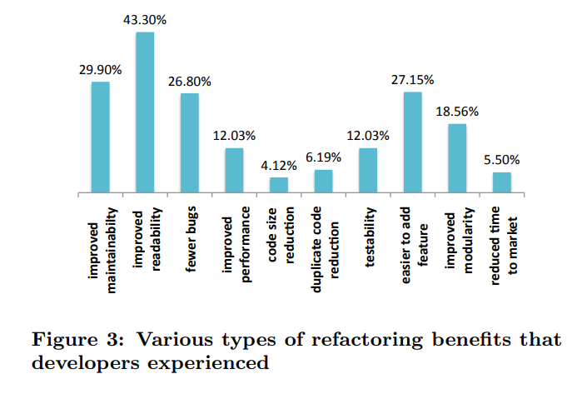
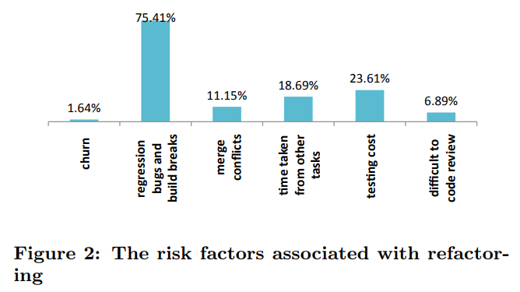
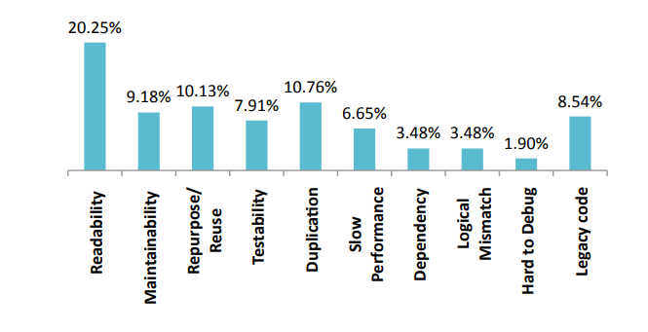
Why, What, and How to Refactor?
A study [11] on Windows development team in Microsoft.
Results: perform manually, improve code readability and maintainability, worry about regression bugs and build breaks
The symptoms of code that
help developers initiate
refactoring :

Slide 64
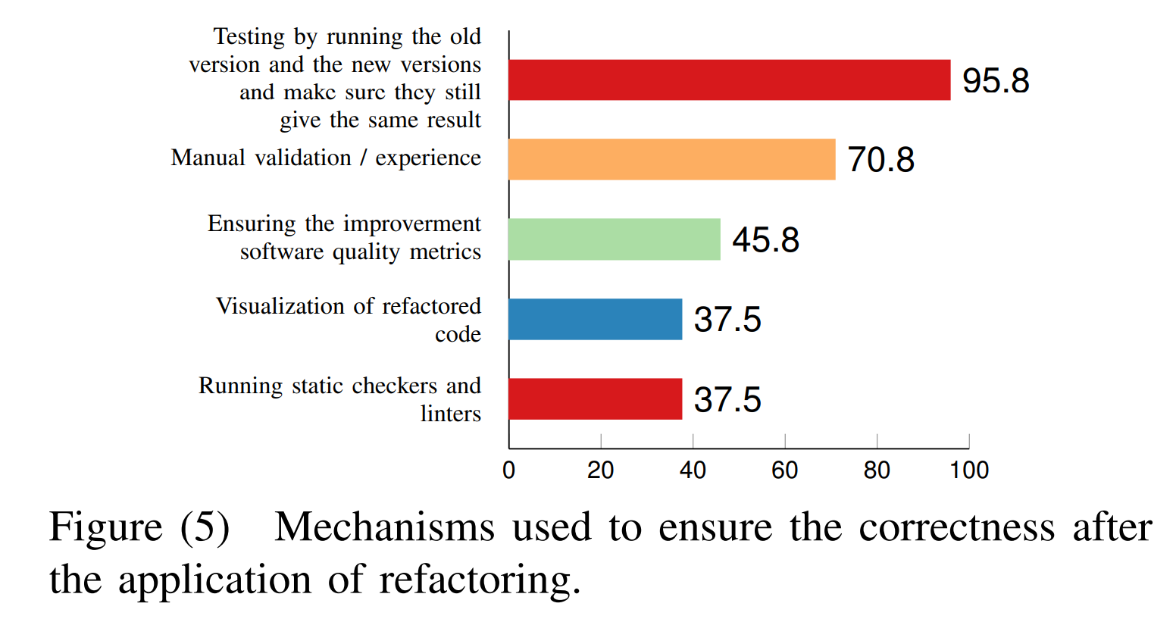
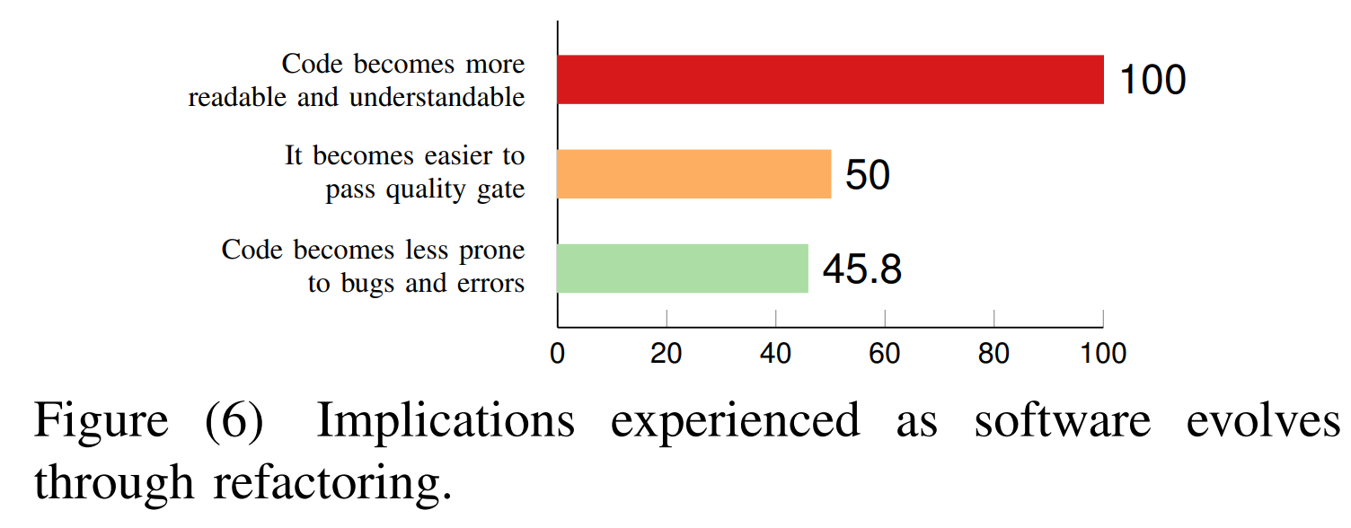
Refactoring correctness and implication of refactoring [13]
24 developers in Xerox

Slide 65
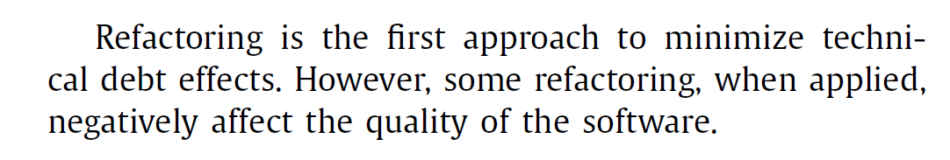
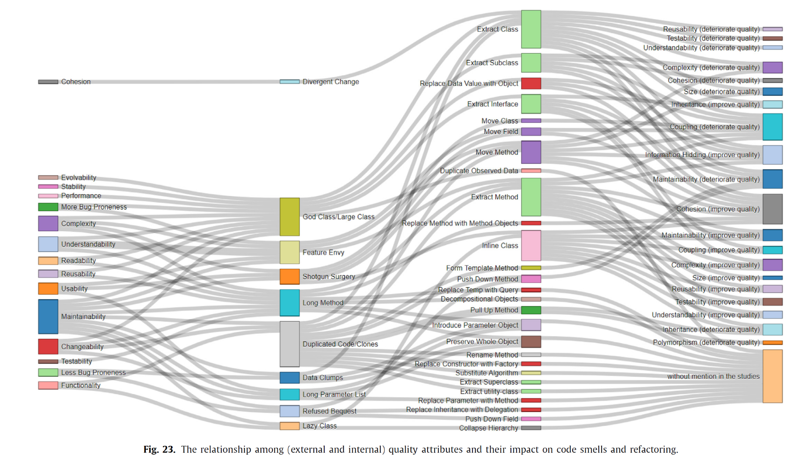
Are Refactoring Always Useful (against Code Smells)?
by Lacerda et al. (2020)[12]
We learned technical debt (TD) in a past week. Code smell is a kind of TD
Improve or deteriorate
deteriorated

Slide 66
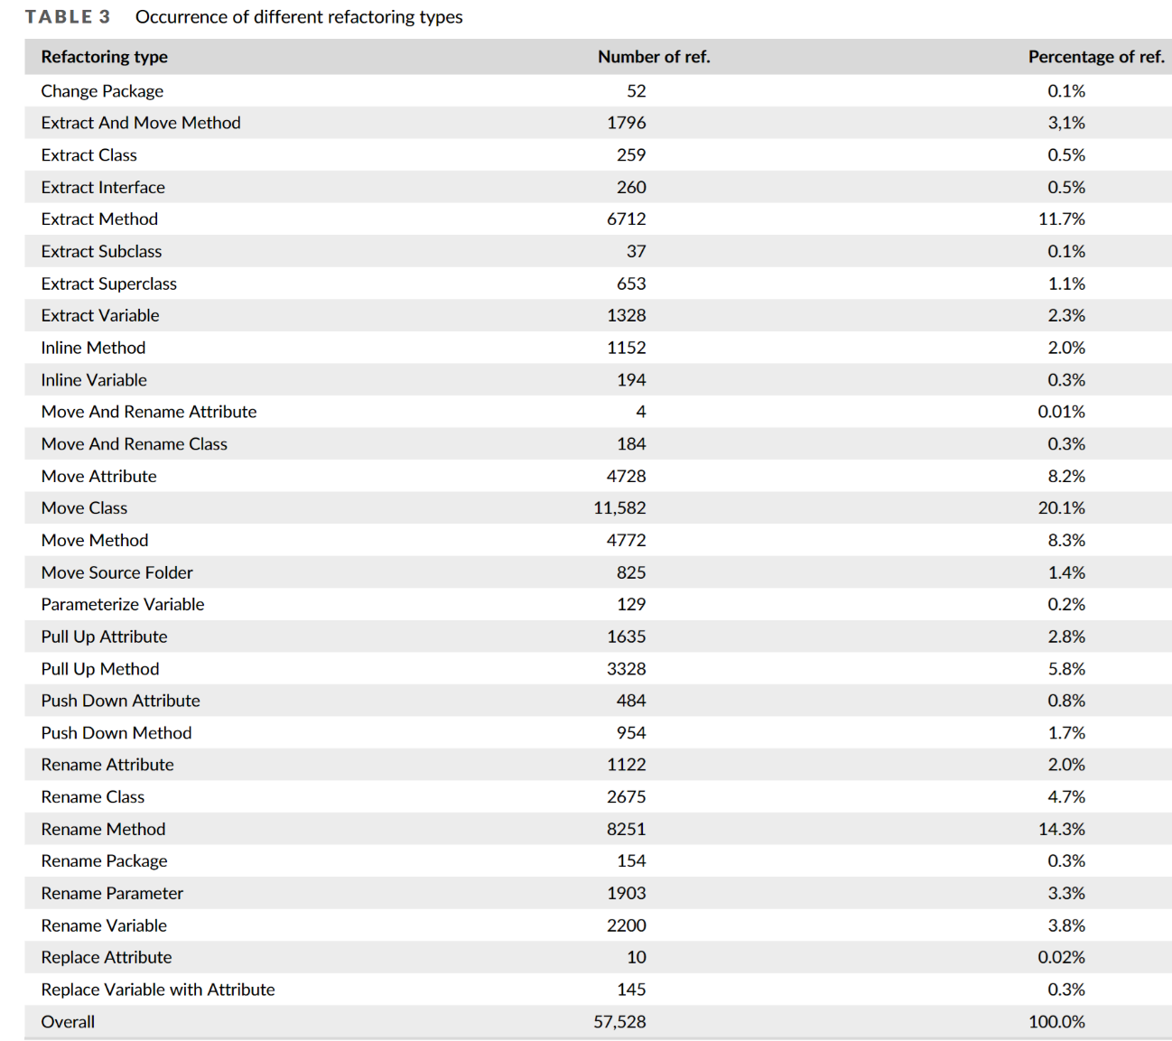
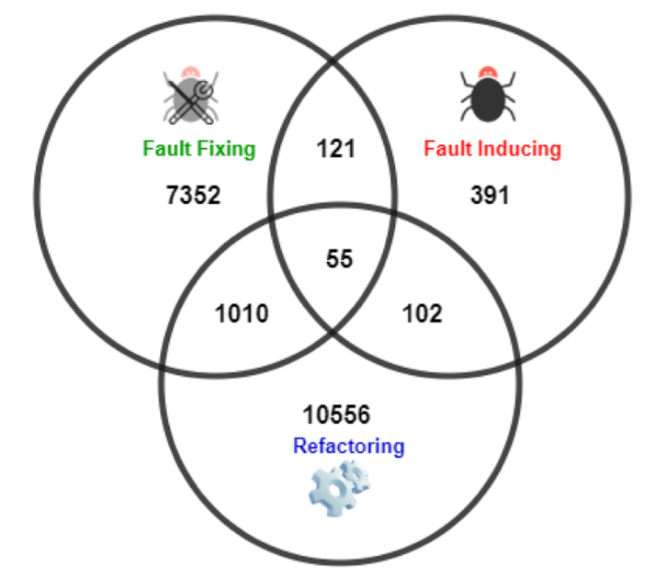
Which Are the Refactoring Methods Used?
A study on 33 projects in the Apache Software Foundation (ASF) repository (2024)
# of commits
23% of Refactoring activities are related to the commits that induced at least one fault in the system
https://onlinelibrary.wiley.com/doi/pdf/10.1002/smr.2447

Slide 67
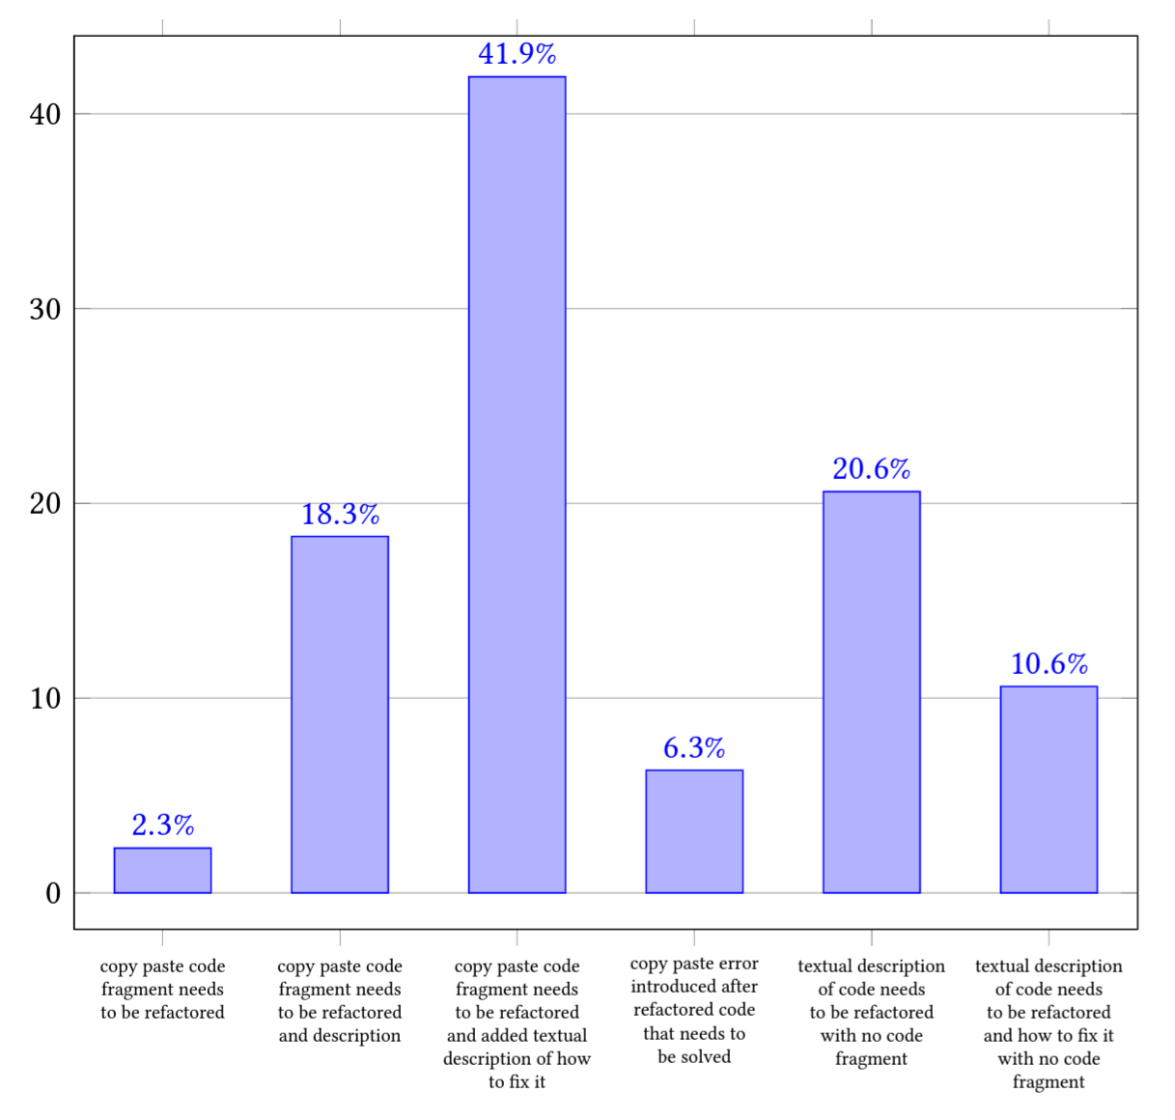
Patterns to Use ChatGPT for Code Refactoring
https://dl.acm.org/doi/pdf/10.1145/3643991.3645081 (2024)
[41.9%] Copy and paste code fragments to be refactored and add textual descriptions of how to fix them.
[20.6%] Textual description of code needs to be refactored with no code fragment
[18%] Copy and paste code fragment to be refactored with textual descriptions
Good for minor change suggestions. Faulty for complex one. Outputs change over time.
https://doi.org/10.1016/j.eswa.2024.123602 (2024)

Slide 68
GenAI for Code Generation
Good and Issue
https://stacklok.com/static/2025.06-stacklok-state-of-ai-codegen.pdf

Slide 69
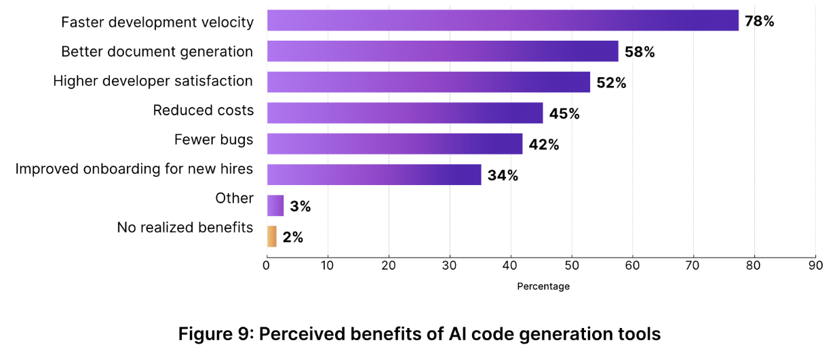
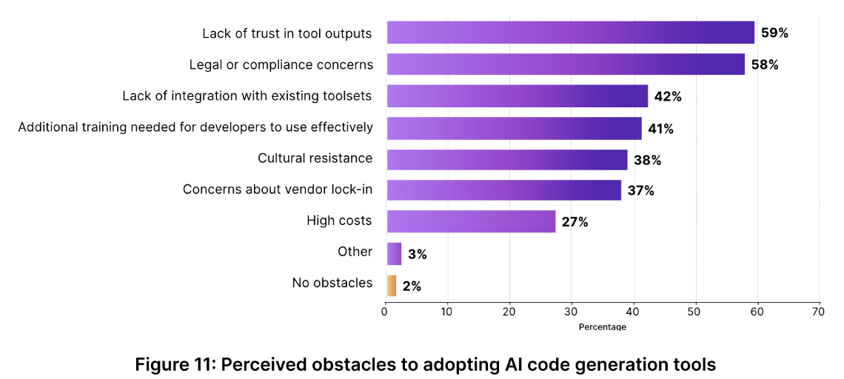
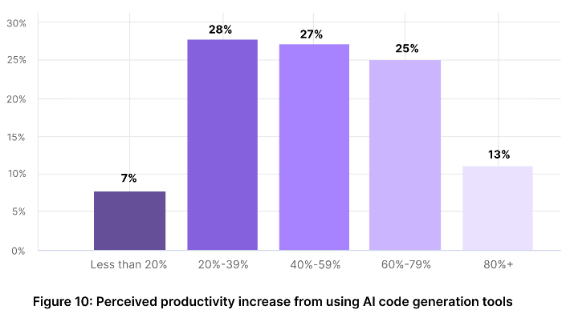
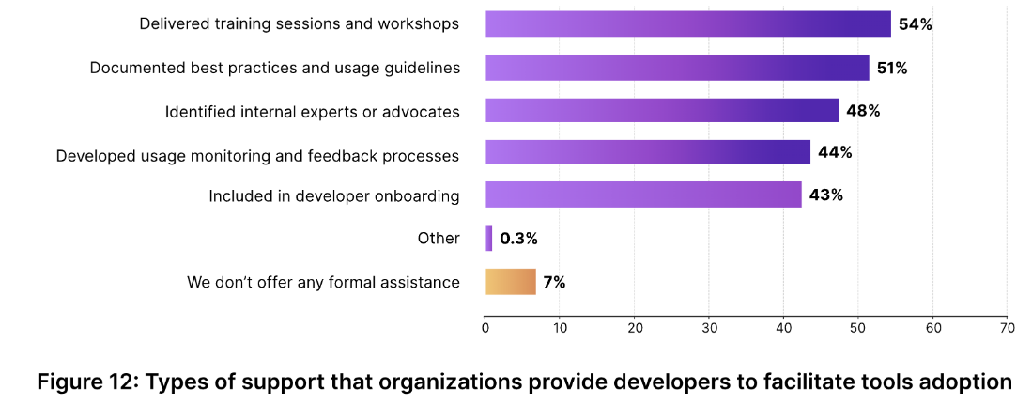
Survey by StackLock (Summer 2025)
300 engineering leaders worked in companies with 100+ employees and lead team of 10+ developers

Slide 70
Summary
Maintaining code structure is important
Accumulating problems in the code will lead to have more code changes, more latent bugs, and less comprehensible code “in the future”
Manage the amount of code smells in code
Refactor the code to improve code readability and maintainability, either manually or with tool assistance, if developers are confident about validation of changes and able to handle code changes across different branches in version control system.
Note that removing all of them is never an option

Slide 71
References and Resources
Bertrand Meyer, 1988. Object-Oriented Software Construction. Prentice Hall. ISBN 0-13-629049-3.
Introduce both design by contract and open-closed principle
Barbara H. Liskov and Jeannette M. Wing. 1994. A behavioral notion of subtyping. ACM Trans. Program. Lang. Syst. 16, 6 (November 1994), 1811-1841. DOI=http://dx.doi.org/10.1145/197320.197383
Introduce the substitution principle
Foutse Khomh, Massimiliano Di Penta, and Yann-Gael Gueheneuc. 2009. An Exploratory Study of the Impact of Code Smells on Software Change-proneness. In Proceedings of the 2009 16th Working Conference on Reverse Engineering (WCRE '09). IEEE Computer Society, Washington, DC, USA, 75-84. DOI=http://dx.doi.org/10.1109/WCRE.2009.28
http://swat.polymtl.ca/~foutsekh/docs/TechReport.pdf
Foutse Khomh, Massimiliano Di Penta, Yann-Gaël Guéhéneuc, and Giuliano Antoniol. 2012. An exploratory study of the impact of antipatterns on class change- and fault-proneness. Empirical Softw. Engg. 17, 3 (June 2012), 243-275. DOI=http://dx.doi.org/10.1007/s10664-011-9171-y
Visual Studio Analyzer: https://docs.microsoft.com/en-us/visualstudio/code-quality/?view=vs-2017

Slide 72
References and Resources
Marwen Abbes, Foutse Khomh, Yann-Gael Gueheneuc, and Giuliano Antoniol. 2011. An Empirical Study of the Impact of Two Antipatterns, Blob and Spaghetti Code, on Program Comprehension. In Proceedings of the 2011 15th European Conference on Software Maintenance and Reengineering(CSMR '11). IEEE Computer Society, Washington, DC, USA, 181-190. DOI=http://dx.doi.org/10.1109/CSMR.2011.24
Martin Fowler. Refactoring: Improving the Design of Existing Code. https://martinfowler.com/books/refactoring.html
Martin Fowler. https://refactoring.com/catalog/
A long list of possible static analysis for code smell detection: https://github.com/mre/awesome-static-analysis
Tom Mens and Tom Tourwé. 2004. A Survey of Software Refactoring. IEEE Trans. Softw. Eng. 30, 2 (February 2004), 126-139. DOI: https://doi.org/10.1109/TSE.2004.1265817
Miryung Kim, Thomas Zimmermann, and Nachiappan Nagappan. 2012. A field study of refactoring challenges and benefits. In Proceedings of the ACM SIGSOFT 20th International Symposium on the Foundations of Software Engineering (FSE '12). ACM, New York, NY, USA, , Article 50 , 11 pages. DOI=http://dx.doi.org/10.1145/2393596.2393655
A longer version: https://www.microsoft.com/en-us/research/wp-content/uploads/2016/02/kim-tse-2014.pdf

Slide 73
References and Resources
Guilherme Lacerda, Fabio Petrillo , Marcelo Pimenta, Yann Gaël Guéhéneuc. 2020. Code smells and refactoring: A tertiary systematic review of challenges and observations. Journal of systems and software 67 (2020) 110610. https://doi.org/10.1016/j.jss.2020.110610
Eman Abdullah AlOmar, Hussein Alrubaye, Mohamed Wiem Mkaouer, Ali Ouni, Marouane Kessentini: Refactoring Practices in the Context of Modern Code Review: An Industrial Case Study at Xerox. ICSE (SEIP) 2021: 348-357

